Slide 1
Class 05 – Transformation II

Slide 2
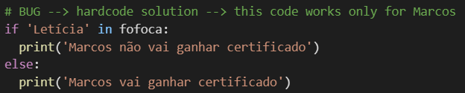
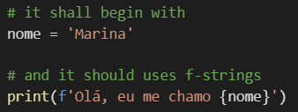
Exercise – Programming Logic
Exercise:

Slide 3
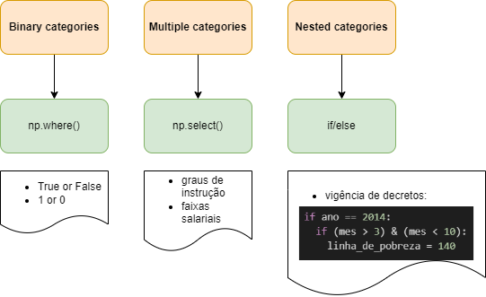
Create a column based on another columns

